Slide 1
Dime Magazine
How successful leaders use language to influence the mind of the people.

Slide 2
Cont
ents
06
Rosa Park
We want the same rights
07
The leader of nonviolence
03
Change
MLK, a man that used words to spread love
Think outside the box
08
Martin Luther King Jr
“I Have a Dream”
04
The rise of
Malcolm X

Slide 3
“Be the change that you wish to see in the world”

Slide 4
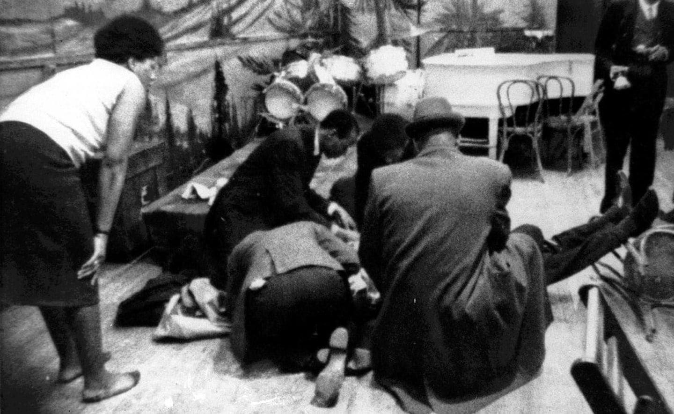
Malcolm X was born in Omaha, Nebraska, a human right activist that wanted to bring Africa ways of unity back to the United States. He started in Harlem, New York, where--Africa American decent was the largest at that time.
On February 21, 1965 he was shot by Islam members while giving a speech at one of his organizations in New York City.

Slide 5
One of his famous quotes is “By Any Means Necessary”. The meaning behind this is bring about the freedom of these people by any means necessary. If the government is unwilling to protect you, you got to protect yourself. African Americans should no longer wait for no government to bring about changes. But we, African Americans should rally up and take the freedom that belonged to us.

Slide 6
It took one brave woman named Rosa Park to challenge the social norms during the mid-1950s. It was a cold December day that she was asked to give up her seat. After refusing with the operator, she was arrested. After this incident, people started to boycott buses and walked or biked to work instead. She inspires people today of her courageous and rebellious act.
The power behind the word “no” has brought the freedom to the people.

Slide 7
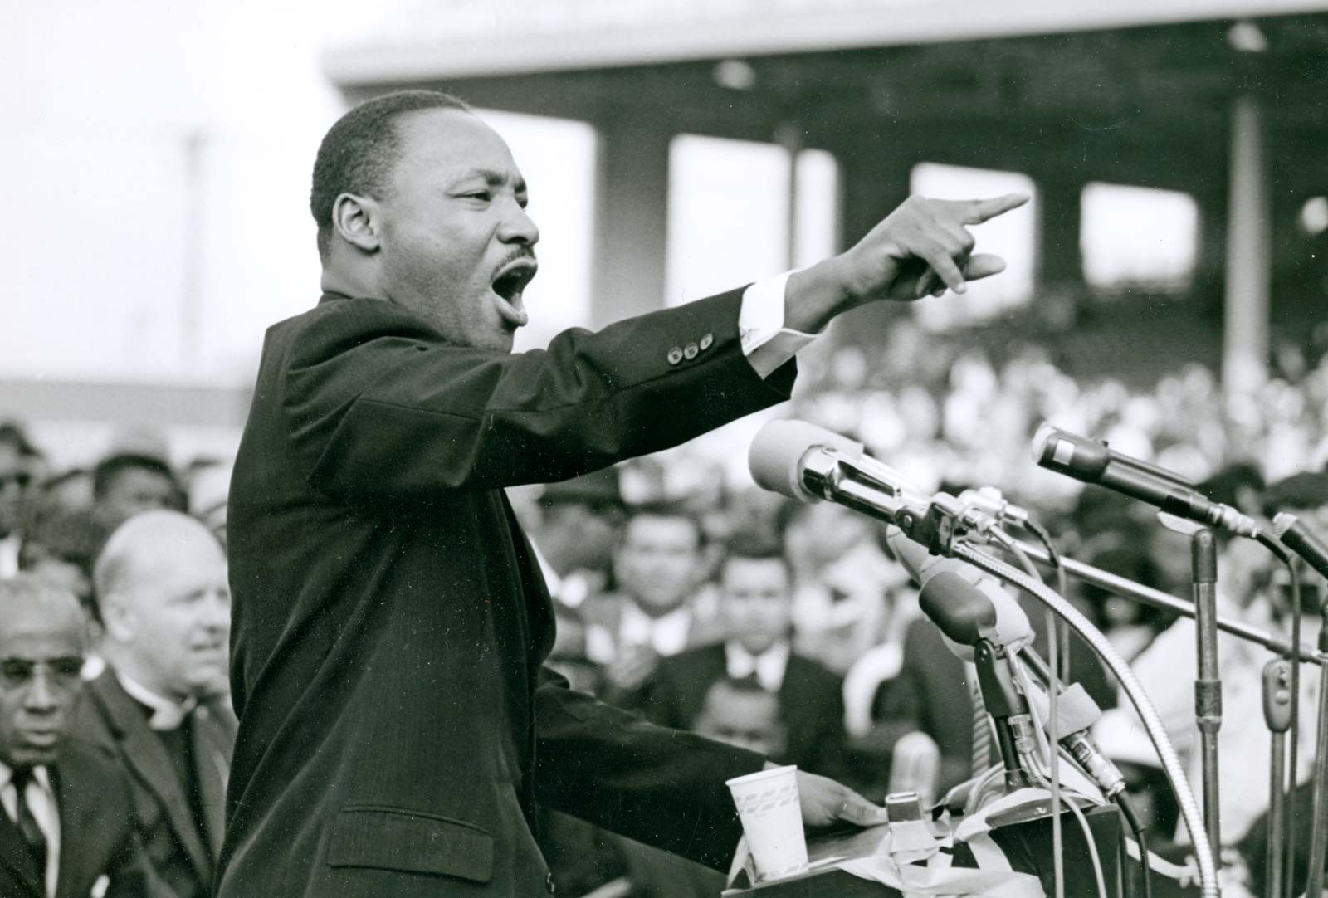
On 28 of August 1963, Martin Luther King Jr. delivered one of the most famous speech called, “I Have a Dream”. In his speech, he talks about having a dream that his children can co-exist with white children and not be judged based on their skin color. He would repeatedly say “I have a dream” and “with this faith” as a way to connect to people like him that feel that discrimination is unfair and should come to an end.

Slide 8
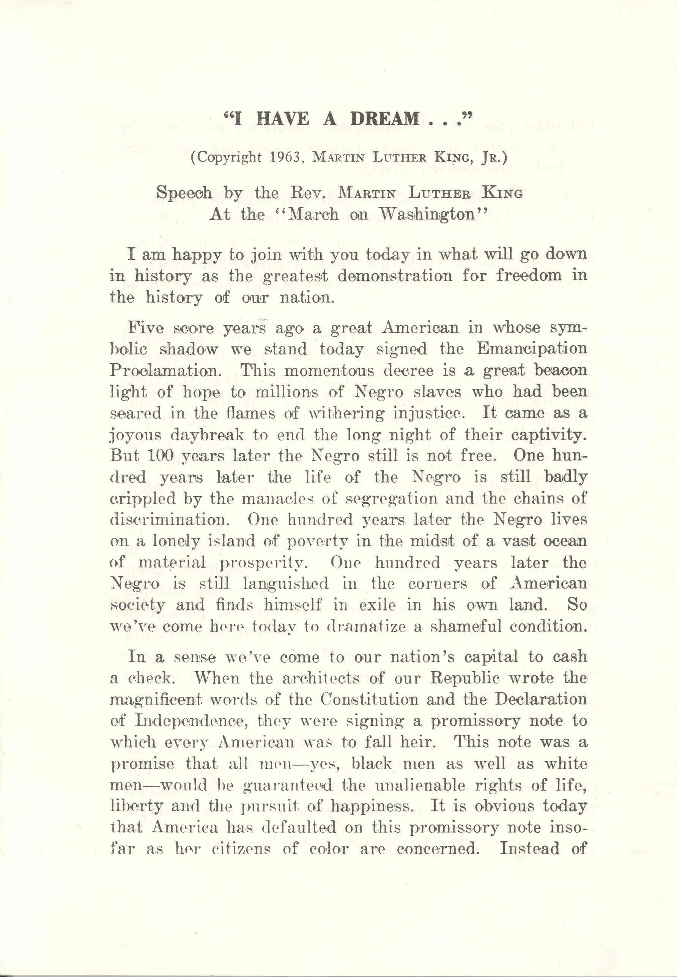
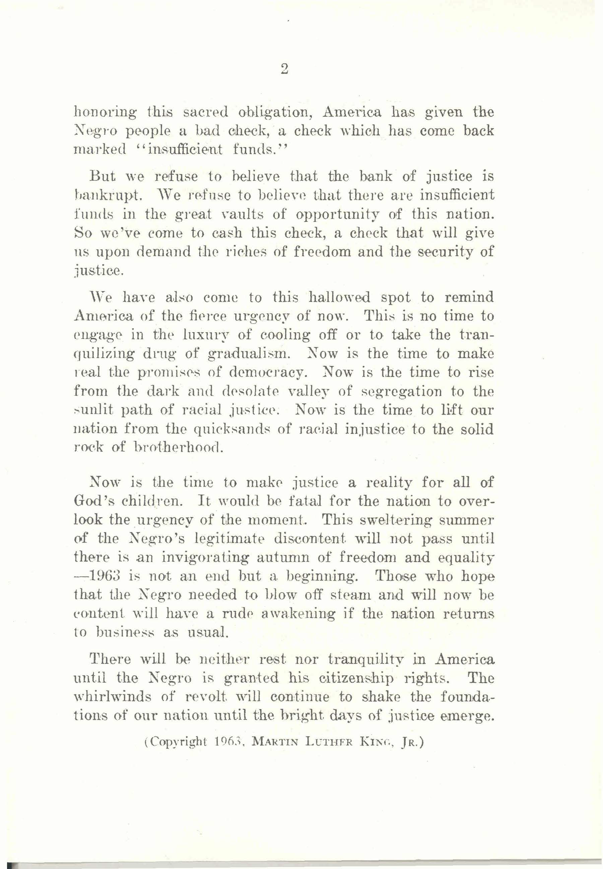

Slide 9
Inspired by the interest in black studies
Contributed from my inquiry essay
Had an amazing time putting this together

